Slide 1
MFEP & EAP Portal
How to:

Slide 2
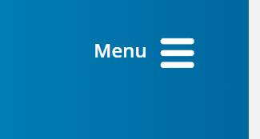
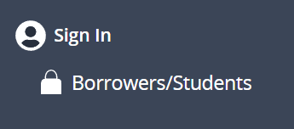
www.pheaa.org

Slide 3
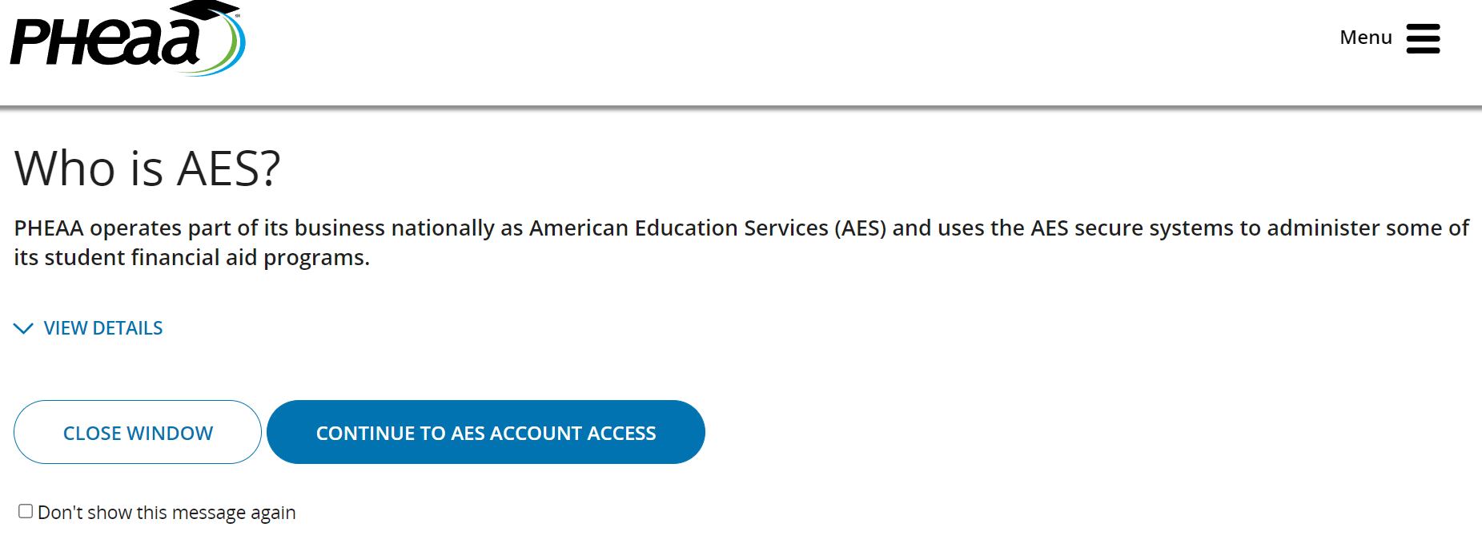

Slide 4
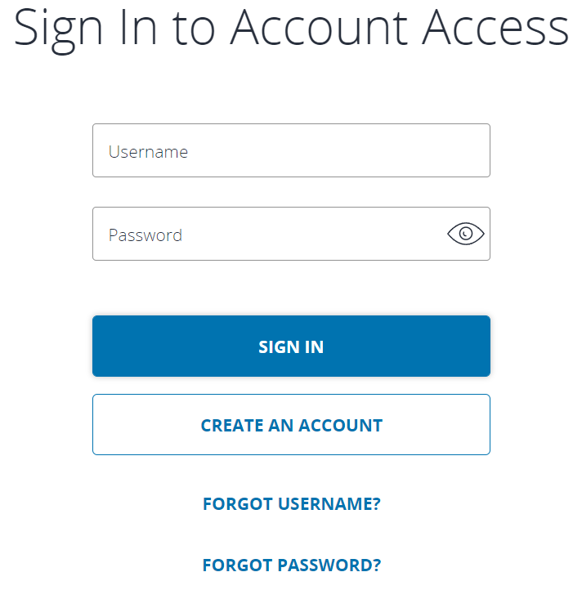
Sign in
If this is your first time, you will need to create an account. This will link you with your previous paper application (if that applies to you) via your SSN
If you or a dependent have ever submitted a FAFSA, you may already have an account, as all PA state funding utilize the same system
If this is the case and you do not recall your account information, you will need to take the steps to retrieve your information with “forgot username” and/or “forgot password”

Slide 5
Once you have gotten into your account in:
Scroll down to and select:

Slide 6
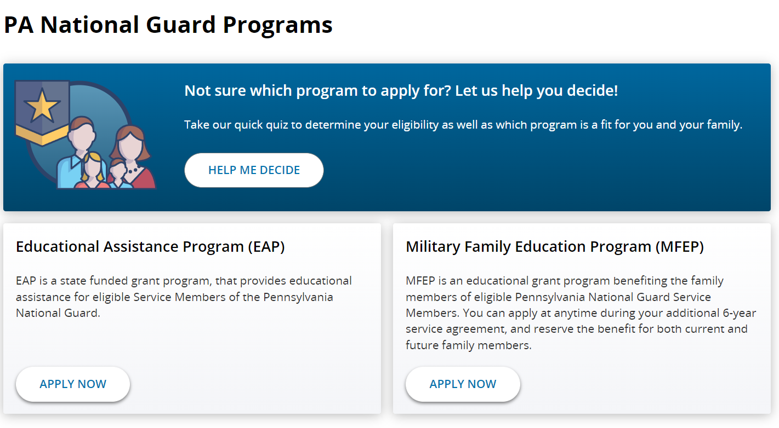
Select which program applies to your current situation
For MFEP, note: If you had already applied via a paper application previously, all of your information will show up after selecting the MFEP button
You will go here to review the benefit and/or make any adjustments

Slide 7
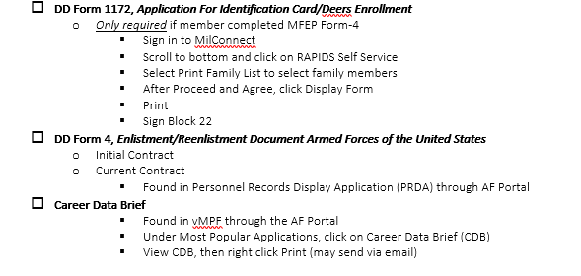
For those new to applying for mfep: (no previous paper application submitted on your behalf)
SUBMIT YOUR APPLICATION AS SOON AS POSSIBLE AFTER REENLISTING OR EXTENDING: This program is no longer able to be backdated and there is a 6 year service obligation
You will need source documents in order to submit your application

