Slide 1
Post 9/11 (Ch.33) Brief
MSgt Alex Wagner
Email: alex.wagner.3@us.af.mil
Cell / Office: 412-313-7509 / 412-776-7636

Slide 2
Post 9/11 Defined
Post 9-11 GI Bill (Chapter 33)
Service Eligibility: After 9-11-2001
- 90 cumulative days of Title 10 and
- 180 or more consecutive days Title 32 AGR
Only GI Bill you can transfer to a dependent
Post 9-11 GI Bill Chapter 33 Payments:
- Tuition and Fees (annual max of $26,042.81)
- BAH (monthly, dependent on schools zip code)
- Books Stipend ($1000 per year maximum)

Slide 3
How Do I Qualify?
Service in any Active Component of the Armed Forces
Service under Title 10 USC Sections 688, 12301(a), 12301(d), 12301(g), 12301(h), 12302, 12304, 12304a, or 12304b.
In the National Guard of a state for the purpose of organizing, administering, recruiting, instructing, or training the National Guard; or
▪ Under a Declaration of National Emergency as follows:
▪ Between Sep 11, 2001 – May 31, 2002 under Operation Noble Eagle.
▪ Effective February 15, 2019 – in support of the Southwest Border Mission under Operation Guardian Shield.
▪ Effective March 22, 2020 – in response to the COVID-19 Pandemic.

Slide 4
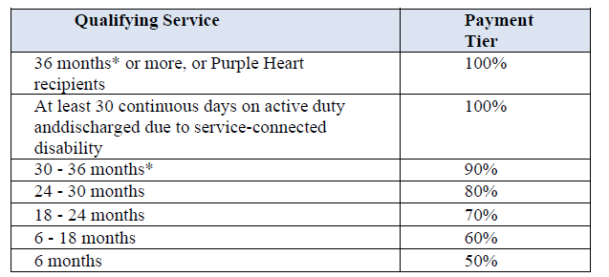
Qualifying Service
DD214 or ARPC verification for all periods of qualifying service required for approval.
Basic Training and AIDT time count towards total after 80%

Slide 5
IADT & Non- Qualifying Periods
Initial Active Duty Training (including Basic Training, Tech school, TFOT) cannot be added to qualifying time unless the Airman:
- Attended all or a portion of IADT on or after September 11, 2001
- Completed 24 months of other qualifying active duty time.
The following periods of service are NOT qualifying time for Post-9/11:
- Service terminated due to defective enlistment agreement.
- Less than 180 consecutive days of Temporary AGR
- Any service period with less than an Honorable Discharge.

Slide 6
Period of Eligibility
For Airmen whose last day of qualifying active duty was prior to January 1, 2013, eligibility to use Chapter 33 benefits expires 15 years from the date of the last Honorable discharge or release from active duty of at least 90 consecutive days.
For Airmen whose last day of qualifying active duty was on or after January 1, 2013, eligibility never expires.
Airmen who are subject to the 15-year limit can eliminate the limit by completing a new period of qualifying duty of at least 90 continuous days on or after 1 January 2013.

Slide 7
Benefit Payment Information
There are three benefit payments for the Post-9/11 GI Bill:
Tuition and Fees:
▪ Up to 100% of in-state tuition if you are attending a public school.
▪ Max $26,042.81 per year for private or foreign school (effective October 1, 2021).
Monthly Housing Allowance (MHA): (MUST be attending more than half-time)
▪ Equivalent to BAH of E-5 with dependents.
▪ Based on zip code where attending classes.
▪ If attending only online classes: BAH rate is based on 50% of the national average.
▪ Subject to term start and end dates.
▪ Airmen serving on qualifying active duty are NOT eligible for the MHA
Book and Supply Stipend:
▪ $41.67/credit hour.
▪ Up to $1,000 per academic year.

Slide 8
Non-College Degree (NCD) Programs
Post-9/11 may also be used for Correspondence schools, Flight programs, Apprenticeships and On-the-Job Training (OJT), and Independent Study programs.
Students at NCD institutions receive the same benefits as those attending traditional colleges and universities.
Correspondence students will receive the actual net costs for tuition and fees, up to $12,649.34 per academic year (effective August 1, 2021).
Flight students will receive the actual net costs for tuition and fees, up to $14,881.59 per academic year (effective August 1, 2020).

Slide 9
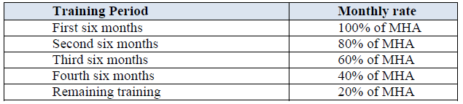
Non-College Degree (NCD) Program Rates
Rates for Apprenticeship and OJT are based on length of time the student is in training:

Slide 10
How Do I Receive My Benefit?
Step 1: Request a Letter of Certification to certify all your qualifying period of service for the Post 9/11 GI Bill.
Step 2: Apply for Chapter 33 Post 911 GI Bill on VA website.
  https://www.va.gov/education/how-to-apply/
Step 3: To check on the status of your application:
  1.Log onto https://ask.va.gov/
  2.Enter your reference number and click “Find My Inquiry”.
  *** Detailed Instructions / How To Guides located on the 171 ARW Sharepoint. Wing Staff → Recruiting & Retention → Retention Announcements ***

Slide 11
References
Title 38 USC, Chapter 33
DoDI 1341.13, Post 9/11 GI Bill, Change 1, 12 July 2018
PGM 014-RSR

Slide 12

Questions?

